Slide 1
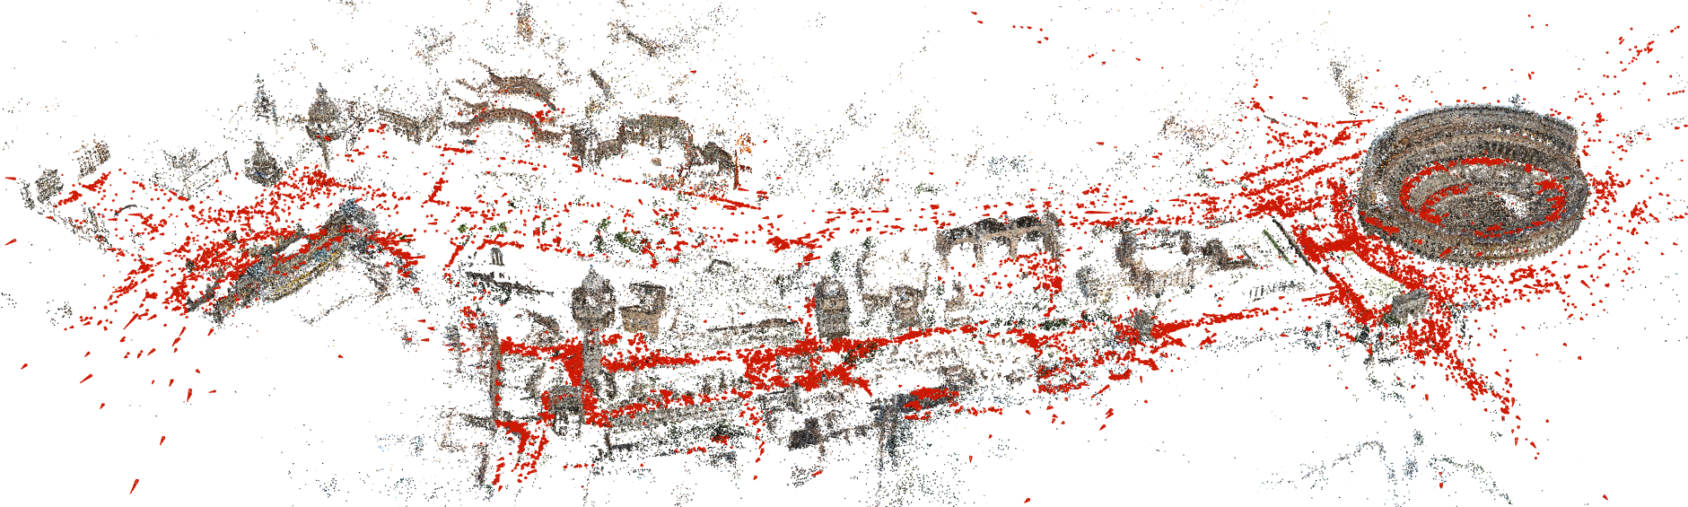
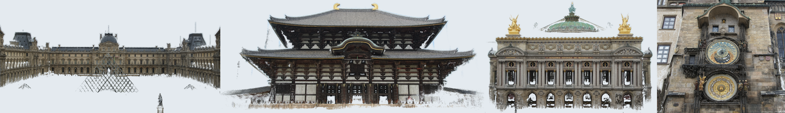
MAPTODON
MAPTODON
Archive the World
Masamune Ishihara Kotaro Suto Shun Kashiwa Dirk Wilson

Slide 2
Introducing…
MAPTODON
Decentralized 3D Scan Map and Sharing Platform

Slide 3
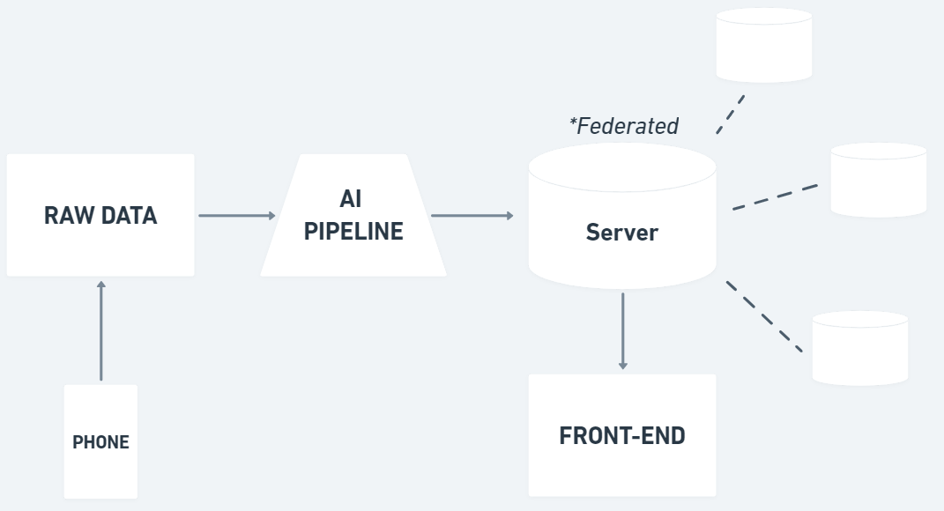
ARCHITECTURE

Slide 4
DATA COLLECTION
EXAMPLE IMAGE

Slide 5
DATA PROCESSING
EXAMPLE IMAGE

Slide 6
DATA PUBLISHING
EXAMPLE IMAGE
3D Environments

Slide 7
KEY ADVANTAGES
Decentralized Servers
3D Environments
Notes:
The two key advantages unique to Maptodon are Decentralized Servers and 3D Environments. We are going to illustrate these advantages with two stories.

Slide 8

Name: Shelton Age: 25
Job: Delivery Driver
Loc: Mozambique, Africa
Notes:
This is Shelton. He has recently moved into a new city in Mozambique, Africa. He makes money by delivering packages to homes, however, he is unfamiliar with the layout of the area.

Slide 9
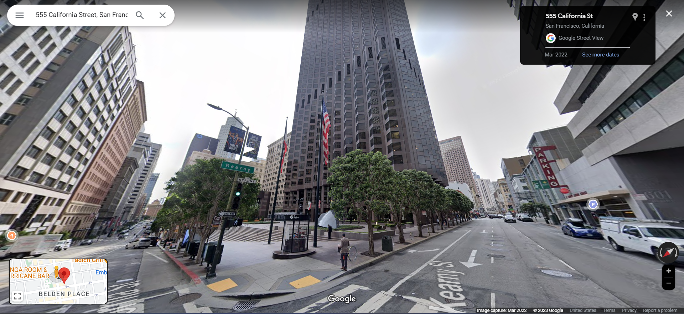
Notes:
Usually, when we want to figure out where we are headed, we use Google SV to get a better sense of the exact destination. If fact, this is what I was looking just before we got here.

Slide 10
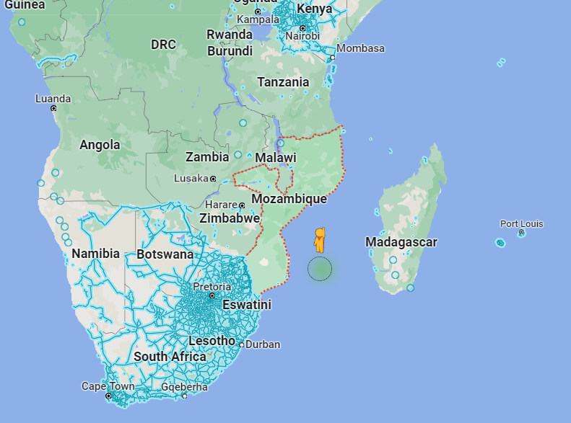
Notes:
HOWEVER, that’s not an option for our man Shelton because there’s no Google SV support in Mozambique. The equipment Google uses to capture SV images is expensive, so they choose not to prioritize his country.

Slide 11
Connect multiple images with lines to server
Notes:
Luckily for Shelton, his government set up a local instance of MAPTODON, which allows local residents of Mozambique to use their own smartphones to create environmental scans. This now allows Shelton to easily spot the exact location he is meant to drop off packages.

Slide 12
KEY ADVANTAGES
Decentralized Servers
3D Environments
Notes:
MAPTODON provided an easy way for locals to upload scans that can be utilized by people like Shelton. However, MAPTODON is more than just a SV clone. With 3D data, MAPTODON provides a novel way of viewing the environment. One such use-case of its 3D capabilities has to do with disaster relief.

Slide 13
Notes:
Our team comes from UC Santa Cruz. Last Winter, a severe storm hit Santa Cruz which caused landslides to occur over major highways.

Slide 14
Insert lack of coverage
Decentralized Servers
3D Environments

Slide 15
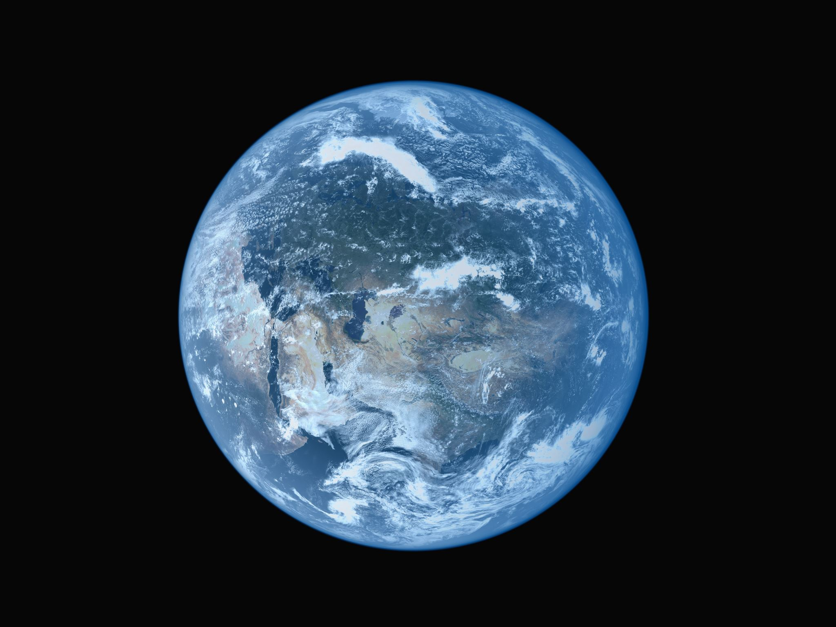
MAPTODON
Key Features
Easily capture 3D surroundings with any device with a camera
Decentralized data with higher focus on community efforts
???

Slide 16
Key Features
Capture photo/video of locations and convert into explorable 3D environmental scans
Users can upload their scans onto federated servers for all to view
Map explorer to browse scans available from all around the world

Slide 17
HOW TO USE
Take photos or videos of an object or your surroundings using any recording device
Upload files to server for media to be converted to 3D scans
Browse the map and view any 3D scans uploaded by Maptodon users

Slide 18
How it Works
Insert graph created by Masa-san

Slide 19
Why a federated server system

Slide 20
Demos

Slide 21


Slide 22
Disaster Response

Slide 23
Historical Preservation
Archive 3D details of environments all over the globe
View past environments and structures even after events causing them to disappear
Preserving details of our world for future generations

Slide 24
More Immersive Education
Crowd-sourced scans to supplement learning in the classroom
Immersive exploration enhances understanding and retention
Culturally important sites more likely to have scans thanks to tourism

Slide 25
Monitoring Ecosystems
Monitoring effects of climate change on ecosystems
Visual representation of an ecosystem’s change overtime
Public engagement: Remotely explore ecosystems
Increased appreciation and funding for preservation efforts

Slide 26
Future Implementations?

Slide 27
Notes
Emphasis on 3D aspect and anyone can contribute
Create a story with this
Covering areas that are not covered
Disaster relief
“There are areas in the world not covered by Google SV” TRUCK DRIVER, WEAK BRIDGE, CAN DO IN US CUZ STREET VIEW, BUT NOT AFRICA. Government put local instance of Maptodon, allowing residents to use basic cameras to create 3D scans. Focus on the fact that anyone can do this one. (Shelton, Mozambique, Africa) Travelling around Africa, delivering [something] to villages in Mozambique. Just started delivery driving. We often use street view to find the proper building to match the address beforehand. Luckily for Shelton, government to instance of Maptodon and utilizes community made scans that were made with usual smartphone. 1…2…3… HOWEVER
We’re not just a clone of Google SV, we also have 3D capabilities, which opens up new use cases. Then talk about better responding to natural disasters. We are students at Santa Cruz. We had a storm. But for Santa Cruz, focus more on the 3D aspect. More disasters global warming, huge storm hit last winter, even Joe came. Landslides occurred in the area and blocked major highways within the area. The government had to get first responders to recon the area. 911 call, caller descriptions not enough. Use Maptodon to get better sense of the situation. Helps with decisions in logistics to recover from the disaster.
AND MORE
Throw a bunch of ideas

